Slide 1
the basics of photography
Web Site:
http://aaccea-photo.org/
The basics of photography
Version Oct/2024

Slide 2
The rules of composition
How does it work ?
Settings and their effects

Slide 3
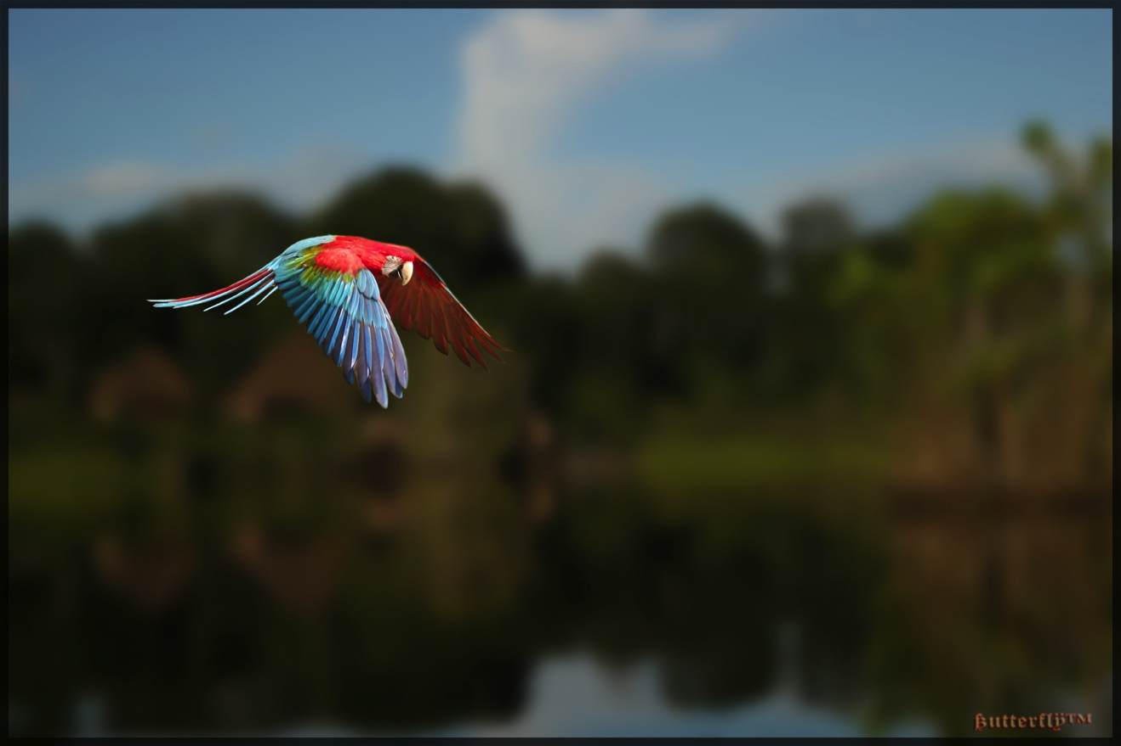
The rules of composition

Slide 4
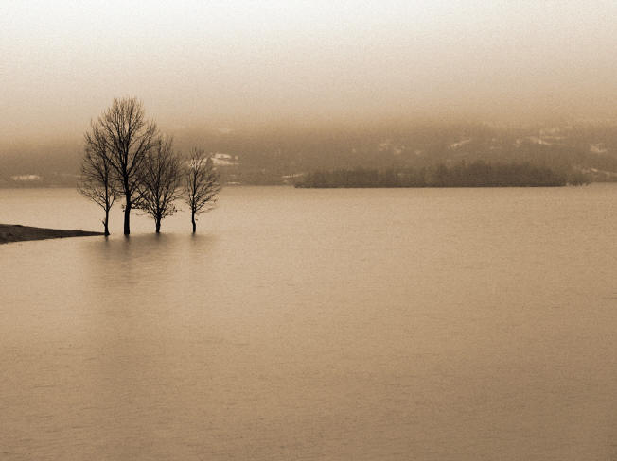
« … comment on construit une image, de quoi une image est faite, comment les formes s’y agencent, comment le tout compose, au final, une unité. »
PAUL STRAND
“ … how we construct an image, what an image is made of, how the shapes fit together, how everything ultimately composes a unity. “

Slide 5
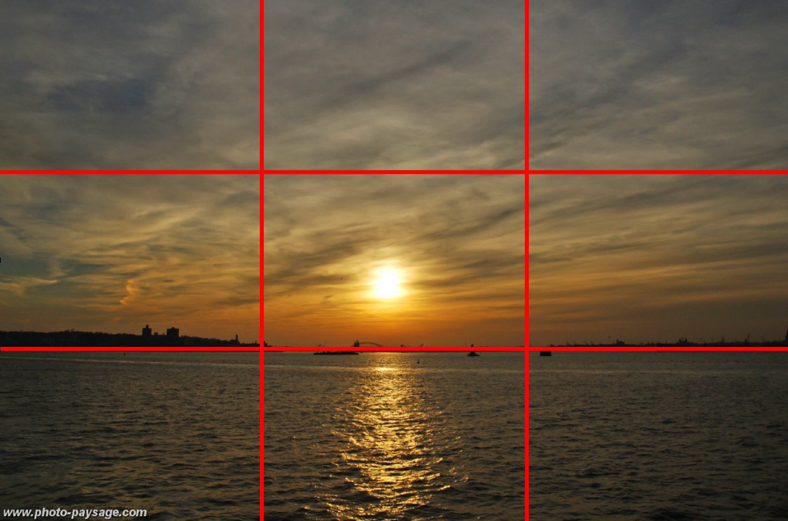
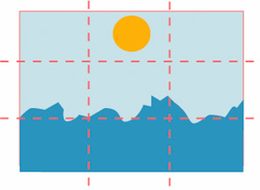
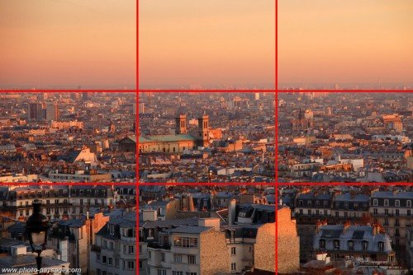
The rule of thirds :
Placez the horizon on the upper or lower third of the image.

Slide 6
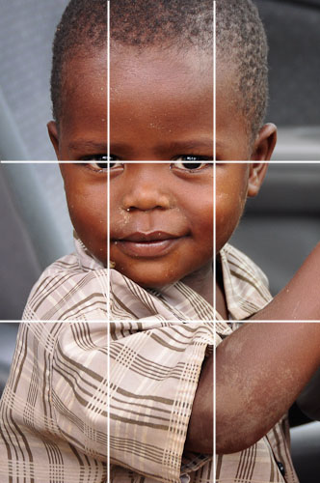
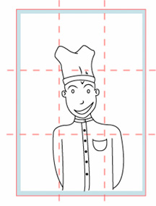
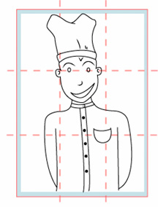
The rule of thirds :
Putting the subject’s eyes in a line of force will give more strength to the image …

Slide 7
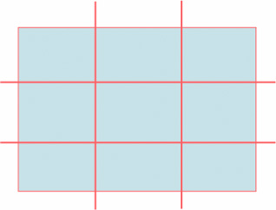
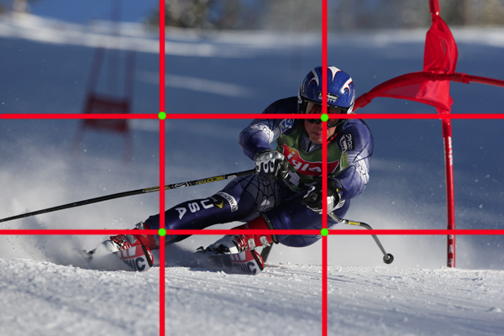
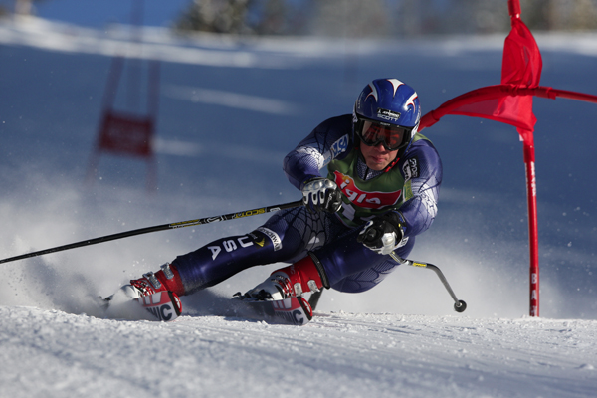
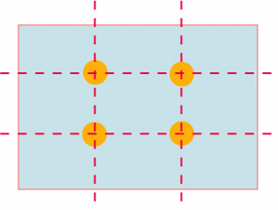
The rule of thirds :
The intersections of these 4 lines are the highlights of the photo.
These are the 4 points to which the eye will be most drawn. So these are the regions were you should place the most important elements of your photo.
Lines of force
Points of strength

Slide 8
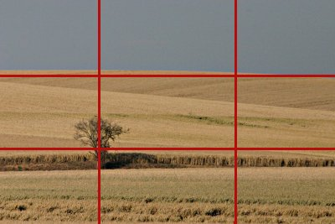
The strong points :
Try placing the subject of your photo (what you want the reader to look at first) on a point of strength in the image.
Points of strength
CAUTION :
The subject which is at the point of strength must be focus otherwise the eye will not stay on it.

Slide 9
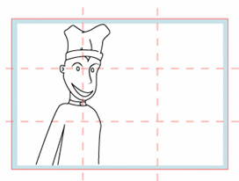
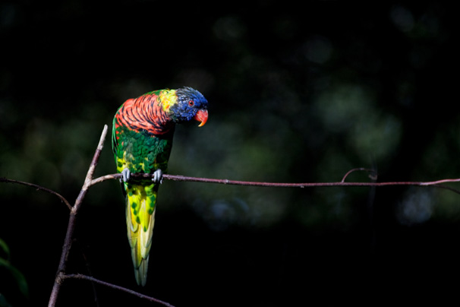
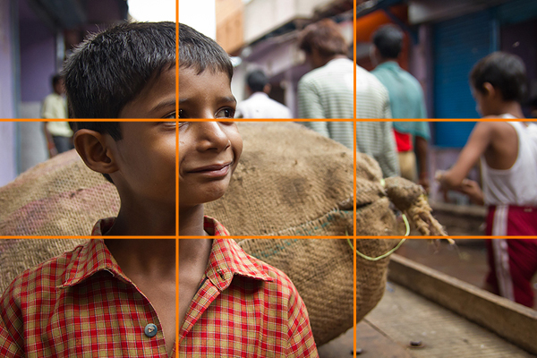
Try as much as possible to leave space:
leave a little space in the direction of a person or animal’s view
in front of a moving subject (car, bicycle, animal)
Leave space :

Slide 10
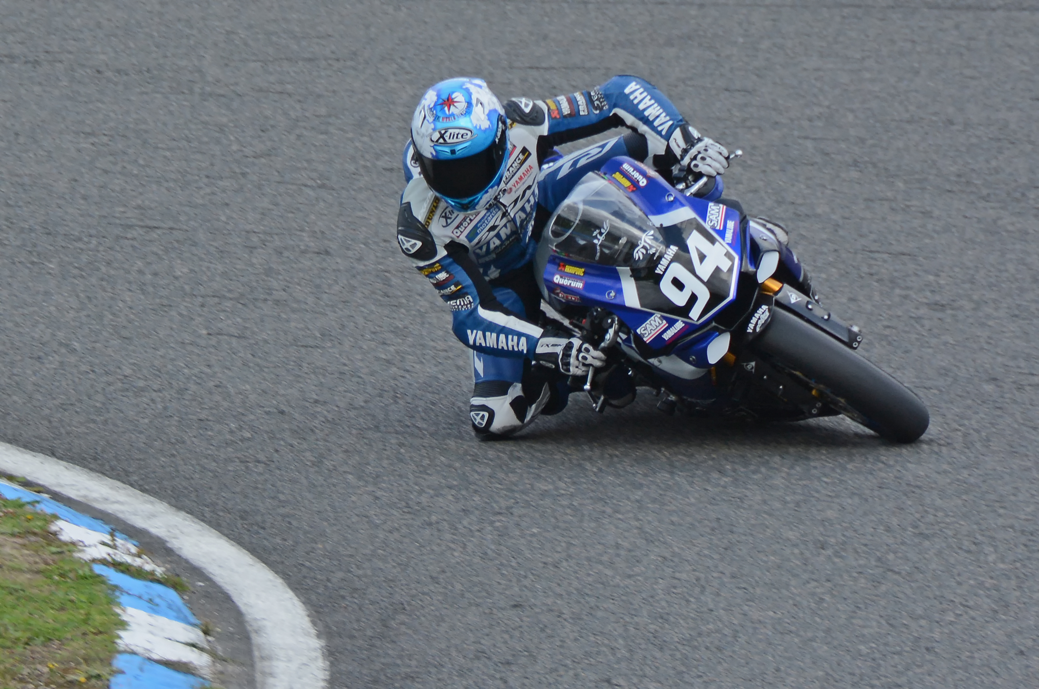

Slide 11
The rules of composition
To strenghten your photo and reinforce its aesthetics, you will need :
Place the subject a third of the picture .
Do not center your main subject but place it on a point of strength .
Give space in the direction of view or movement.

Slide 12
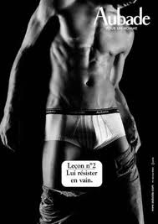
The rules of composition
The eye will scan the surface of an image and will be attracted by a certain number of elements :
- The strength point of the picture
the focus
the first plan
Human appearance (a person, face, eyes etc …)
The lightest area of the picture

Slide 13
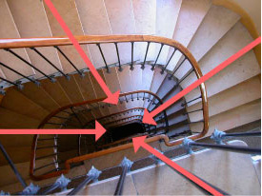
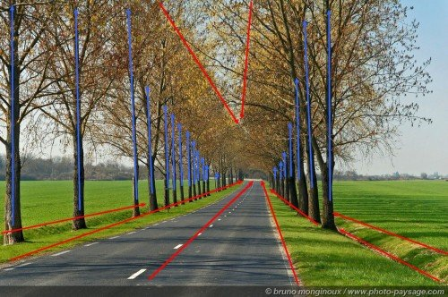
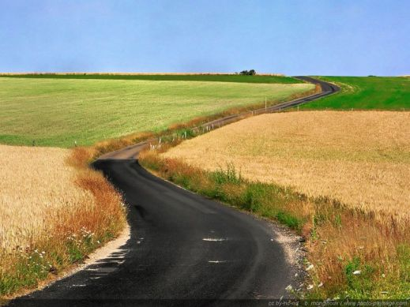
The rules of composition
To draw the eye towards the place that interests us, we can control the guidelines of an image.
These guidelines are defined by the direction of the different elements of the photo.

Slide 14
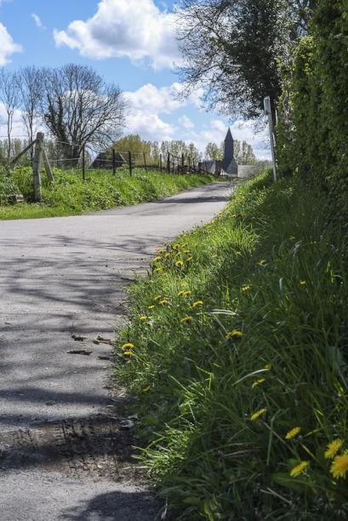
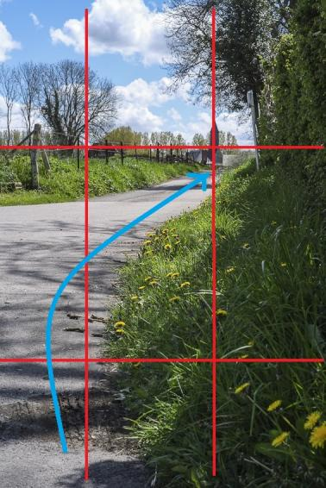

Slide 15
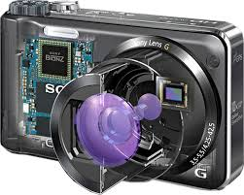
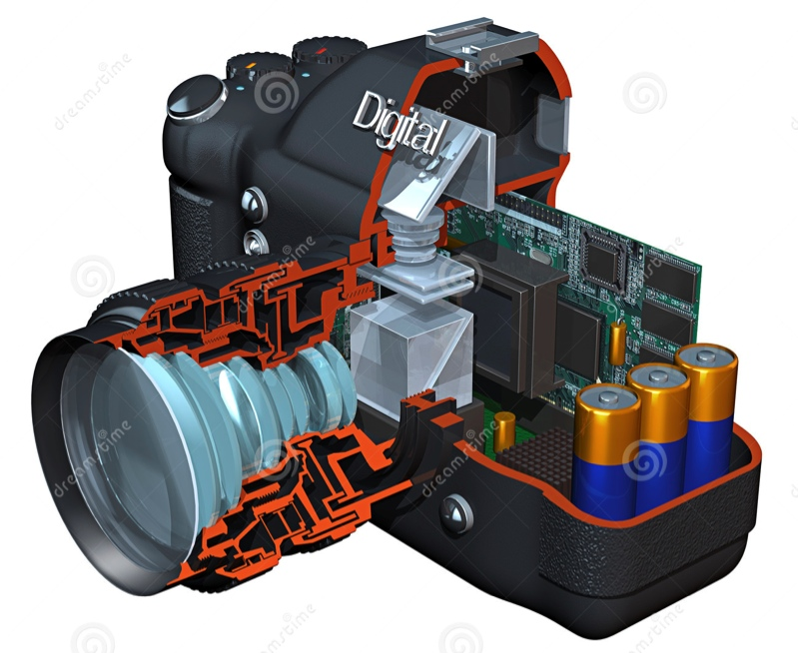
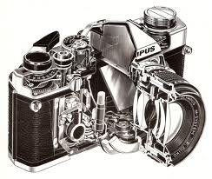
How does it work ?

Slide 16
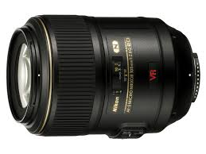
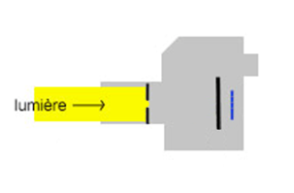
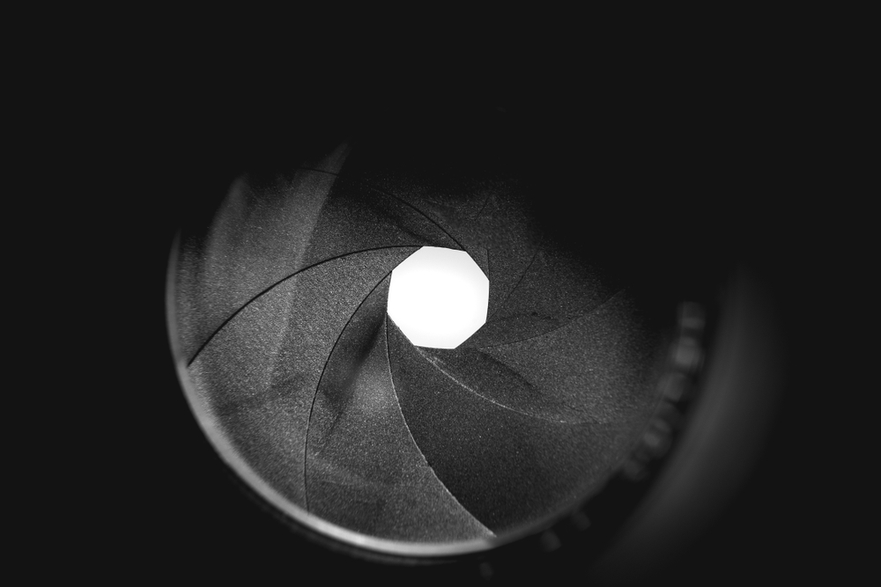
How does it work ?
Three mechanisms:
Diaphragm

Slide 17
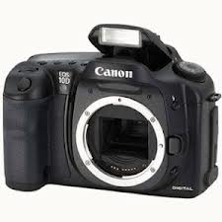
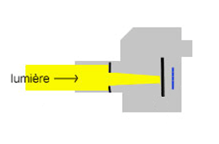
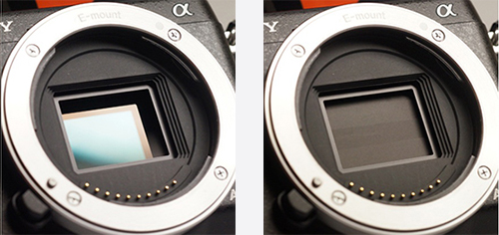
How does it work ?
Three mechanisms:
Shutter

Slide 18
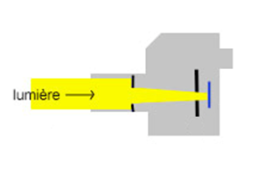
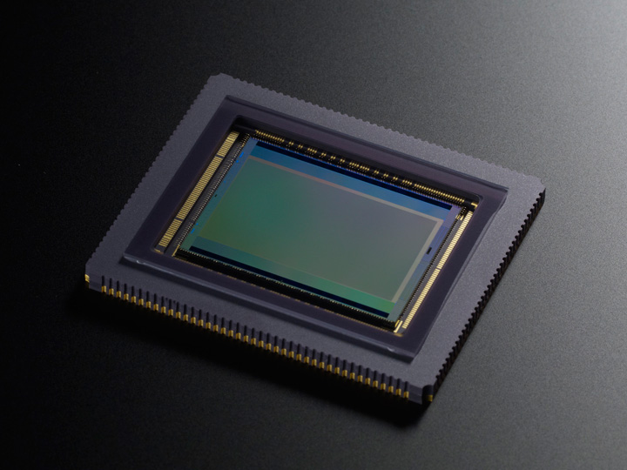
How does it work ?
Three mechanisms:
sensor

Slide 19
How does it work ?

Slide 20
How does it work ?
Three mechanisms:
Diaphragm
Depends on the lens or zoom
f/2.8 ; f/4 ; f/5.6 ; f/8 ; f/11 etc…
Diaphragm

Slide 21
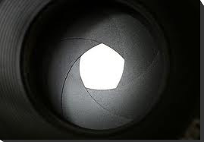
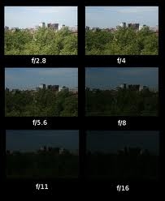
Diaphragm :
It is a device thal allows you to adjust the amount of light that will pass through the camera lens when the shutter is released .
The aperture is expressed in f/x, so more smaller the number more larger is the aperture and more light we let through.

Slide 22
How does it work ?
Three mechanisms:
Diaphragm
f/2.8 ; f/4 ; f/5.6 ; f/8 ; f/11 etc…
2) Shutter
1/1000s 1/500s 1/250s 1/125s etc …
Diaphragm
Shutter

Slide 23
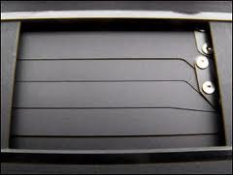
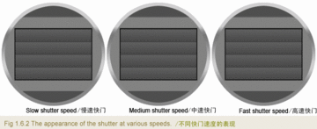
Shutter speed :
Slow
Medium
Fast
The shutter is the mechanism regulating the exposure time
The exposure time is the time during which the shutter curtain will let light (from the lens) pass onto the sensor.
Exposure time is expressed in seconds or 1/X seconds

Slide 24
How does it work ?
Three mechanisms:
Diaphragm
f/2.8 ; f/4 ; f/5.6 ; f/8 ; f/11 etc…
2) Shutter
1/1000s 1/500s 1/250s 1/125s etc …
3) Sensor
Depends on the camera
ISO 100-200-400-800-1600 etc …
Diaphragm
Shutter
Sensor

Slide 25
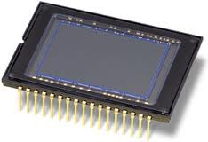
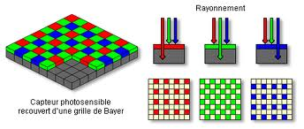
Sensor :
It is the heart of your digital camera.It is thanks to this support that you can save and view your photos on a computer media.
Replacing film, it restores light in a digital image. It is made up of photovoltaic cells which mesure the intensity of light and its color.

Slide 26
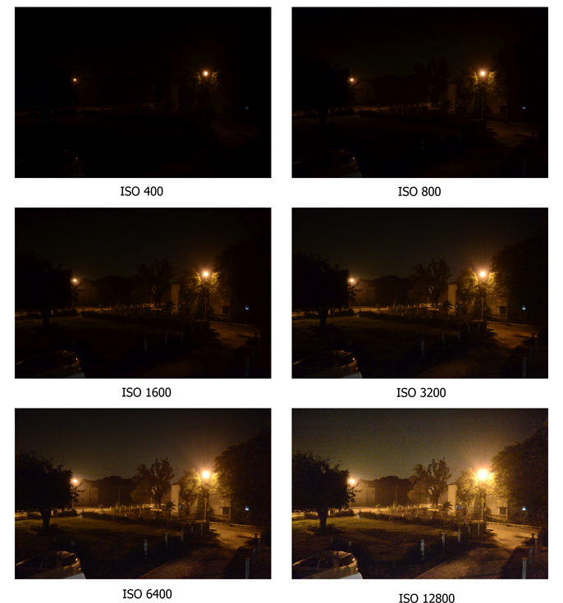
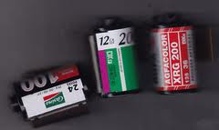
ISO sensitivity:
This is the unit of measurement for the sensitivity of the sensor.
The higher the sensitivity value, the more sensitive the sensor is to light. So a lower amount of light is needed for a correct exposure.

Slide 27
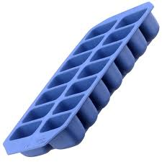
Modulate the light to get the best exposure.
Comparison between your sensor and … an ice cube tray !!!!

Slide 28
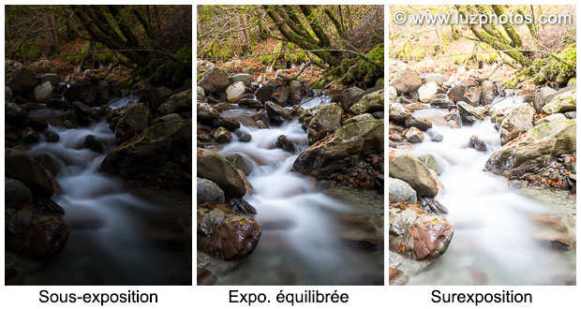
Modulate the light to get the best exposure.
Volume of water :
Not enough Perfect too much

Slide 29
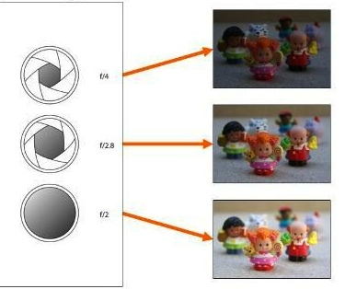
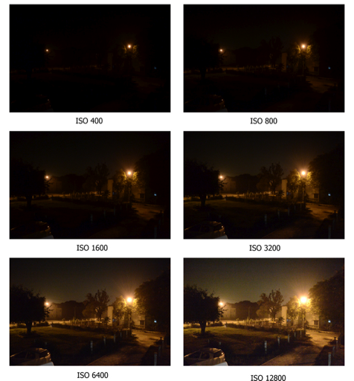
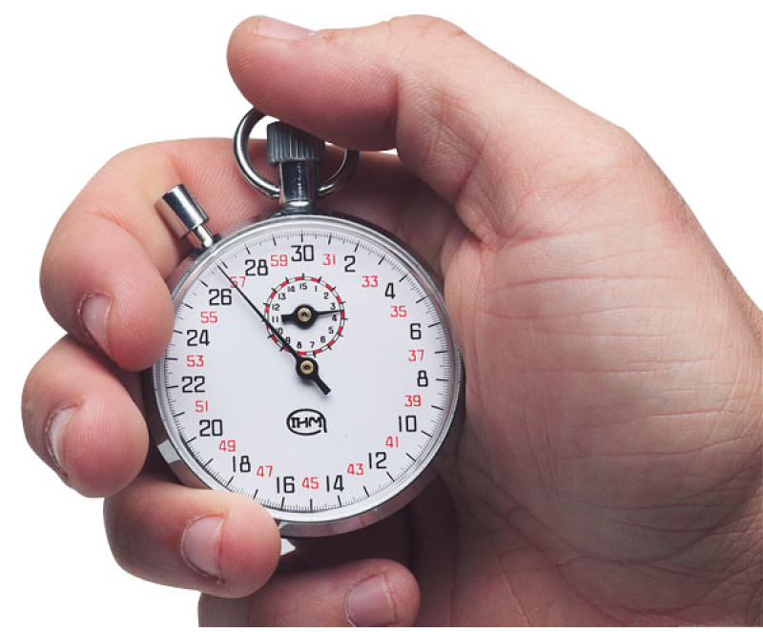
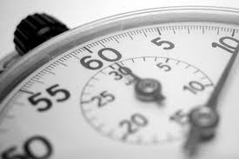
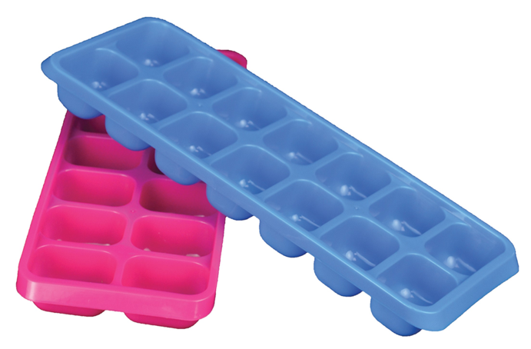
Diaphragm :
Speed :
ISO :

Slide 30
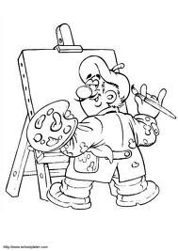
Settings and their effects :
Aperture ; Speed ; ISO
Changing one of these settings always has two effects :
1) Light
2) Artistic

Slide 31
Settings and their effects :
The diaphragm :
Allows you to modify the depth of field.
This is the distance of the focus zone of the picture

Slide 32
Depth of field :

Slide 33
1/1500 ; f2.8 ; ISO 100

Slide 34
Settings and their effects :
Shutter speed :
Allows you to create « artistic blurs »
High speed
Low speed

Slide 35
1/125 ; f14 ; ISO 100

Slide 36
1/100 ; f14 ; ISO 100

Slide 37
5s ; f16 ; ISO 200

Slide 38
Basic settings
ISO setting :
Mainly an effect on the light it will allow for example in the event of low light to maintain a fast speed to avoid motion blur.

Slide 39
1/1000 ; f2.8 ; ISO 2000

Slide 40
1/6 ; f2.8 ; ISO 2000

Slide 41
1/250 ; f1.8 ; ISO 4000
1/250 ; f4 ; ISO 2500

Slide 42
Digital noise :
If you may be tempted to systematically take high sensitivities, you should know that this has an influence on the final image which show more pronounced grain (digital noise).
Depending of your equipment, it is possible to use high ISO with little digital noise …

Slide 43
In summary :
Aperture
Speed
Sensitivities

Slide 44
Change mode !!!!
Diaphragm :
Speed :

Slide 45
To help you manage exposure :
It allows you to see the dispension of the pixels in your image
The histogram :
sur

Slide 46
Exposure compensation :
It allows you to modify the exposure value proposed by the camera .

Slide 47
Thank you for your attention.

